Slide 1
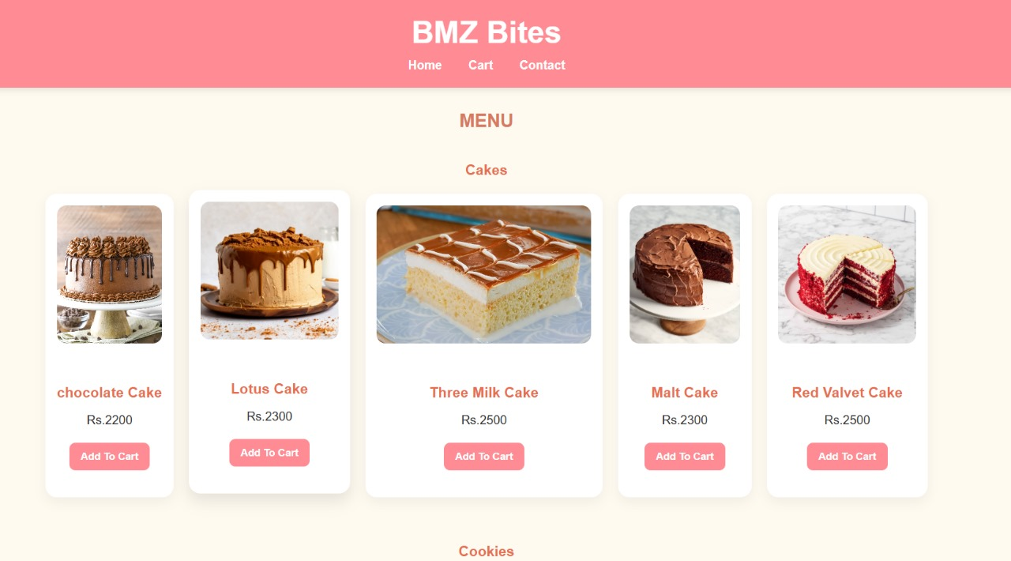
ICT Final Project
FAST – NUCES
CS – Fall 2025
30th Nov 2025
Submitted By:
Bushra Saeed | 25K-0669
Manaal Mehtab | 25K-0960
Muhammad Zohaan | 25K-0726
Submitted To:
Sir Osama Tahir
Project Title:
Bakery Ordering System – BMZ Bites

Slide 2

introduction
The online bakery ordering system, BMZ Bites, is a web-based application. Its purpose is to provide a user with an easy-to-navigate and convenient system for ordering bakery items online. It has a responsive online menu and ordering interface. Moreover, it displays products with prices and has a straightforward cart system included as well. The system ensures that product categories are segregated and easy to navigate. The system has been implemented via HTML for structure, CSS for styling and JavaScript for interactive features.

Slide 3
OBJECTIVES
To develop a user-friendly web interface for ordering bakery items
To implement e-commerce functionality
To make the website easy to navigate through and use
To have an interactive system for ordering and viewing menu
To ensure design is visually appealing to customers

Slide 4
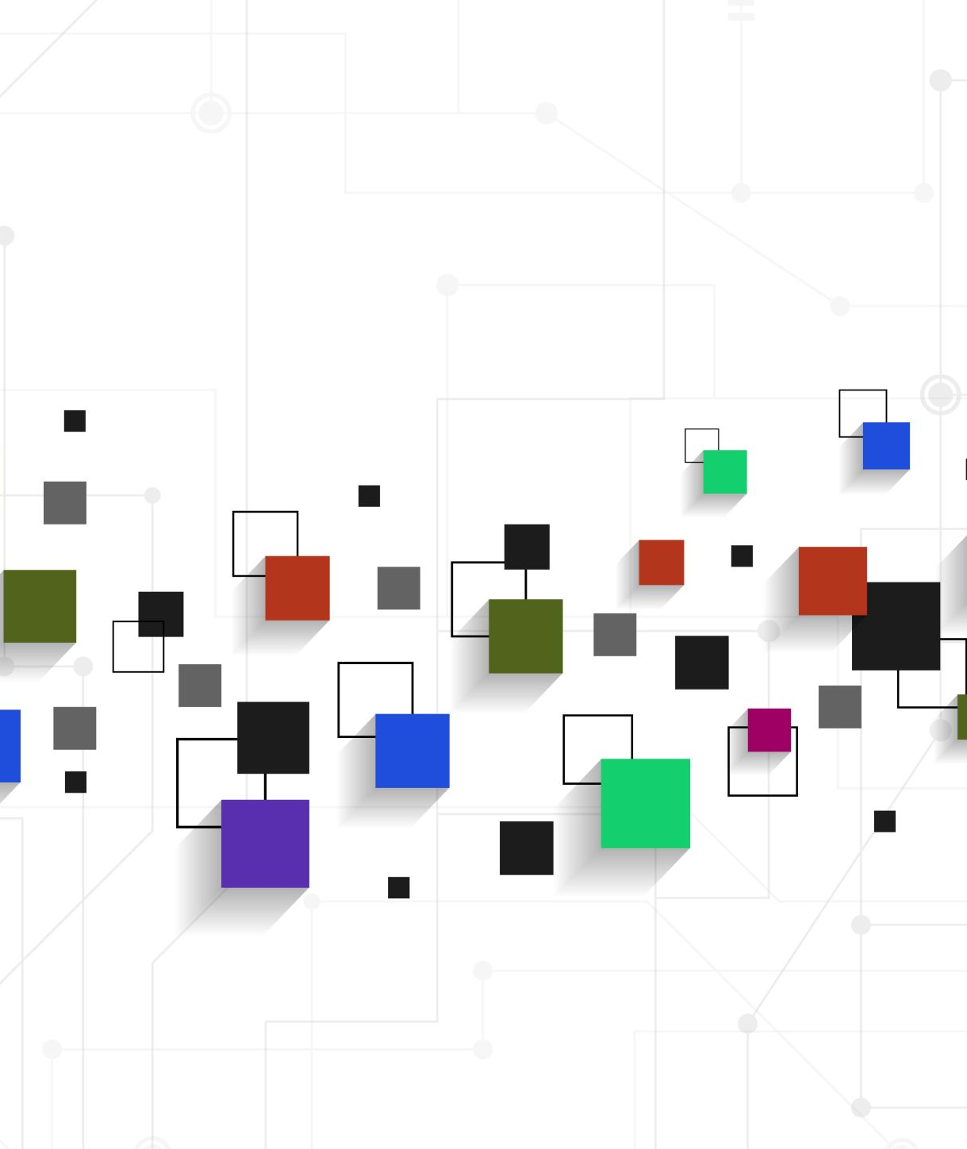
SYSTEM DESIGN
1. System Overview:
HTML provides the structure for the entire website with index.html, contactus.html and cart.html
Style.css handles layout, colors and fonts
Script.js manages the interactive core functionality with add to cart system
2. Input & Output:
Input: User can interact with buttons such as contact and menu and cart while hovering over home and navigating the website.
Output: Display of the menu and products with images and updating cart.

Slide 5
IMPLEMENTATIONS
HTML, CSS and Javascript on Visual Studio Code
KEY FEATURES B)CODE SNIPPET
Menu Categorisation
Dynamic Cart Function
Visual Design
Notifications for add to cart
Special Deals
<div class="item">
<img src="chocolate.jpg" alt="chocolate cake">
<h3>chocolate Cake</h3>
<p> Rs.2200</p>
<button onclick="addtocart('Chocolate Cake',2200)">Add To Cart</button>
</div>

Slide 6
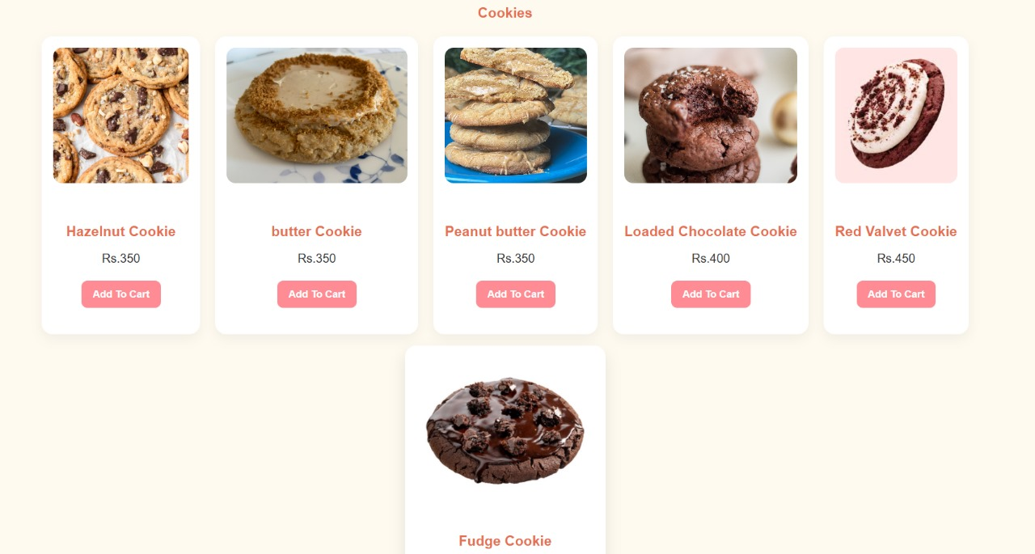
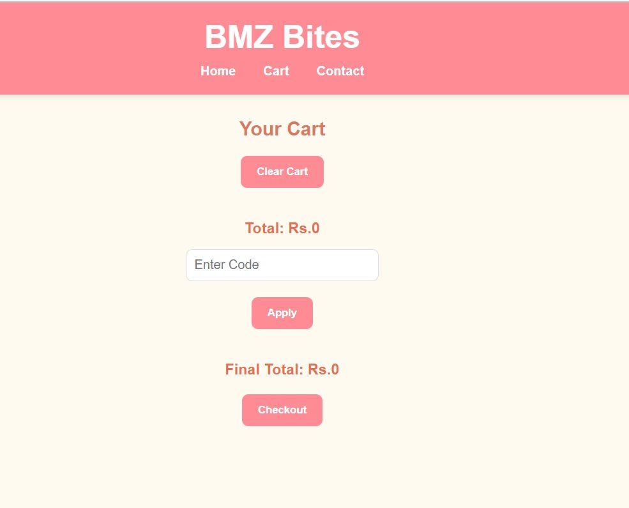
SAMPLE OUTPUTS

Slide 7
TESTING AND RESULTS
Menu Display: All Products are properly displayed with their respective image and price
Add to Cart: Function works as cart is updated and pop up appears when an item is added
Navigation: Website smoothly transitions to the contact and cart page when button is clicked
Styling: Website is styled in a clean and proportionate manner

Slide 8
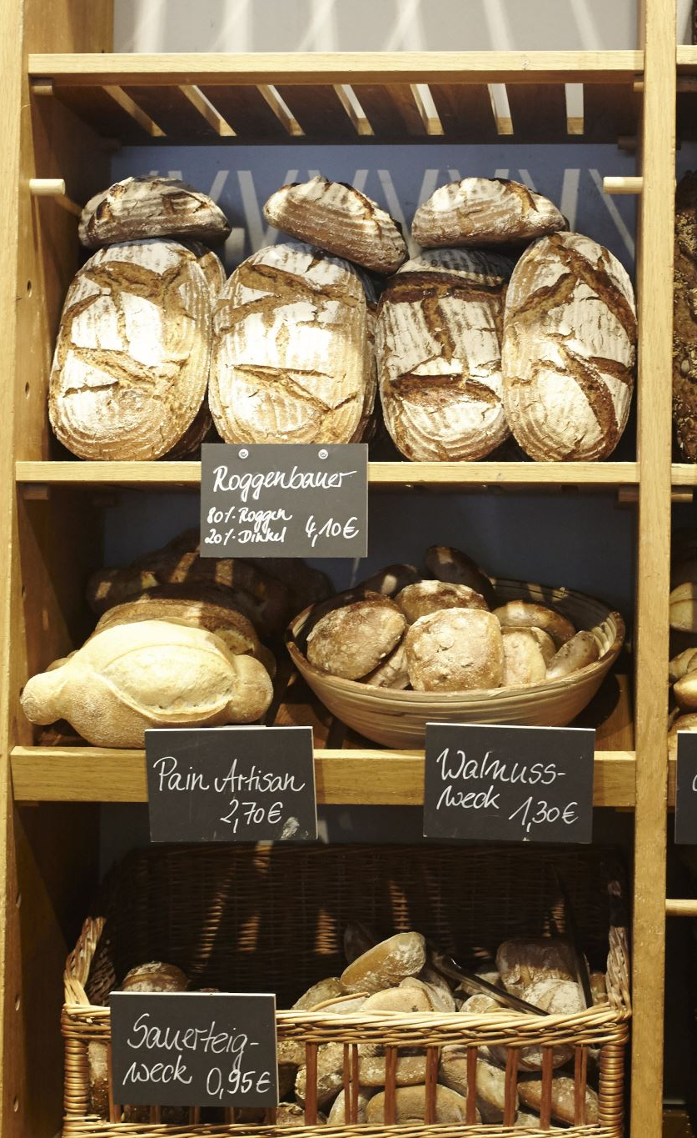
CONCLUSION
The Online Bakery Ordering System successfully implemented a core e-commerce front-end using HTML, CSS, and JavaScript. It meets the primary objectives of providing a visually appealing and organized menu for customers to browse and select products. The use of modern CSS techniques ensures a good user experience.

Slide 9
LIMITATIONS
No Persistent Cart: The cart is managed by JavaScript and likely resets upon page refresh as it lacks local/session storage or a back-end database.
No Server-Side Processing: Orders cannot be actually placed, processed, or saved as there is no back-end technology (like PHP, Python, or Node.js) implemented.
Static Data: Product data is hardcoded in the HTML, requiring manual code edits for any product or price update.
Incomplete Billing/Checkout: The current files suggest a cart page and a billing form are planned but the logic for final payment and order submission is missing.

Slide 10
FUTURE ENHANCEMENTS
Implement Local Storage: Use JavaScript's localStorage to make the cart persistent across browser sessions.
Back-end Integration: Integrate a back-end (e.g., Node.js/Express, MongoDB) to manage product data dynamically, save user orders, and handle payment processing.
User Authentication: Add login/registration features for returning customers to save their preferences and order history.
Admin Panel: Create a separate interface for the bakery owner to update the menu, manage inventory, and track orders.

Slide 11
REFERENCES
Index.html
01
ContactUs.html
02
Cart.html
03
Style.css
04
Script.js
05

Slide 12
THANKYOU!

